Slide 1

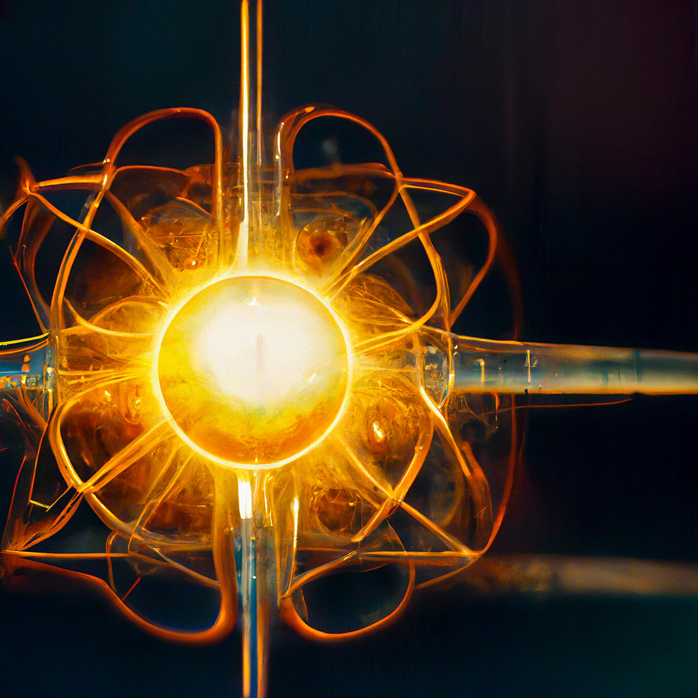

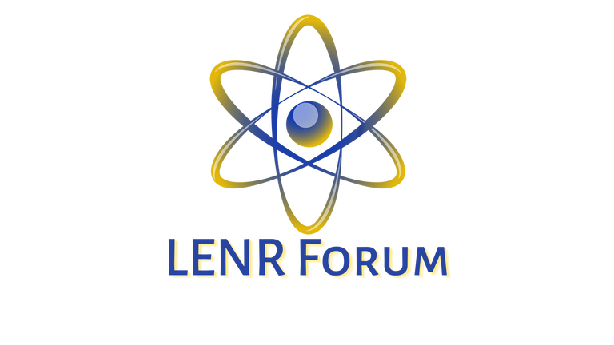

Utilizing Machine Learning Techniques for In-Depth Investigation of Low Energy Nuclear Reactions (LENR) and Lattice-Assisted Nuclear Reactions (LANR)
Author: Diadon Acs
Email: diadon@conscious.energy
Affiliations: www.lenr-forum.com & www.conscious.energy﻿
Conscious Energy
Notes:
Hello, My name is Diadon and I am a researcher and experimentalist with Conscious.Energy and the LENR-Forum.

Slide 2
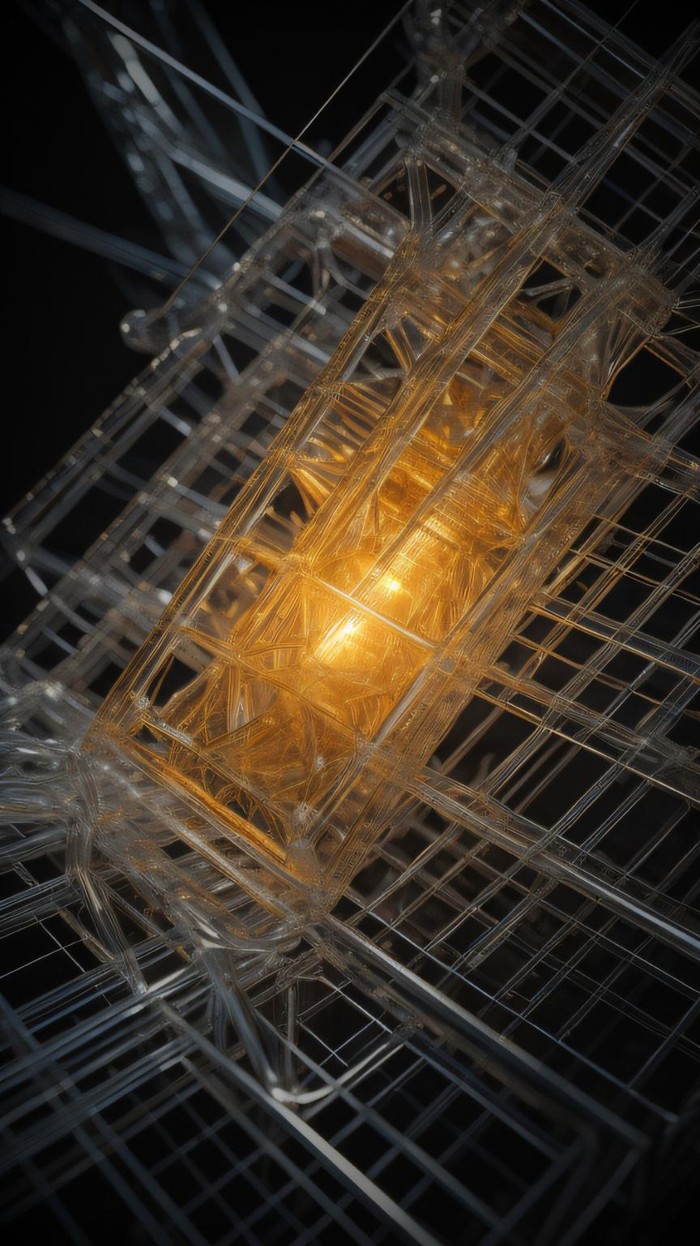
Contents
Introduction
Why Investigate LENR, LANR, LCF, ENC, etc?
Challenges in Investigating LENR and LANR
How Machine Learning can help solve these challenges?
Machine Learning Techniques
Examples of Machine Learning Techniques
Autonomous Research Assistant (ARA) with LLMs (Large Language Models)
Datasets for Machine Learning
Data Preprocessing
Feature Selection
Methodology of Machine Learning in LENR/LANR and the Preliminary Results
Historical Statistical Analysis of LENR using Machine Learning
Statistical Analysis Experiments
Theoretical Model Data Collection
Theoretical Model Analysis
Predictive Model Simulations
Limitations of Machine Learning in LENR and LANR
Collaboration of Open Science and Technology
Open Source vs Closed Source for Technological Adoption Rates
Future Directions for Research
Conclusion
Contact Information and Citation Reference Links
Acknowledgments
Conscious Energy

Slide 3

Introduction
In this presentation, we will review the phenomenon of low energy nuclear reactions and explain how machine learning techniques can be used to investigate them. We will discuss the challenges that researchers face in this field and present some initial results of machine learning investigations into low energy nuclear reactions.
Additionally, we will explore the potential applications of machine learning in this field and discuss future directions for research.
Conscious Energy
Stable Diffusion XL: An LENR Reactor powering computers
1
Notes:
In this presentation, we will review how machine learning techniques can be used to investigate LENR. We will discuss the challenges that researchers face in this area and present some initial results..
Additionally, we will explore the potential applications of machine learning in this field and discuss future directions for research.

Slide 4
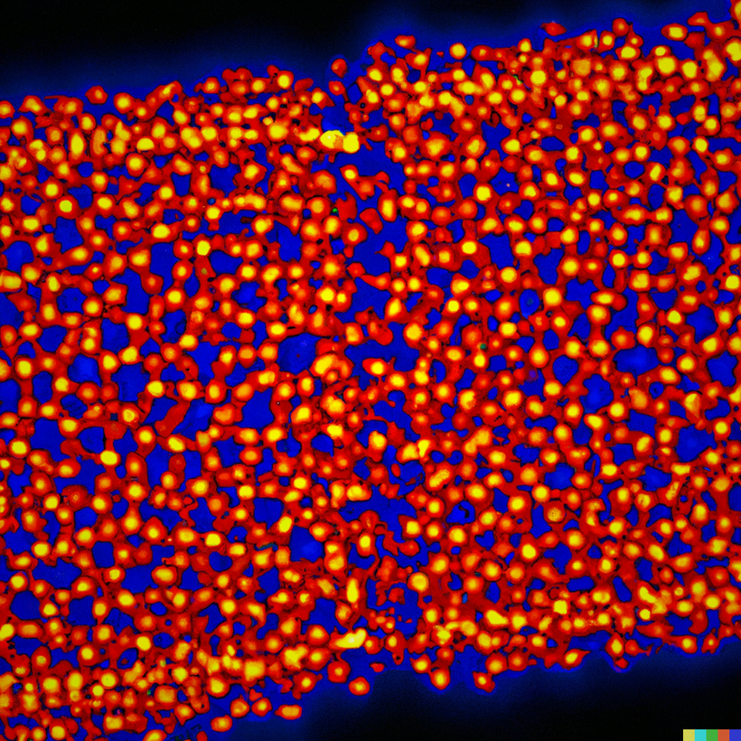
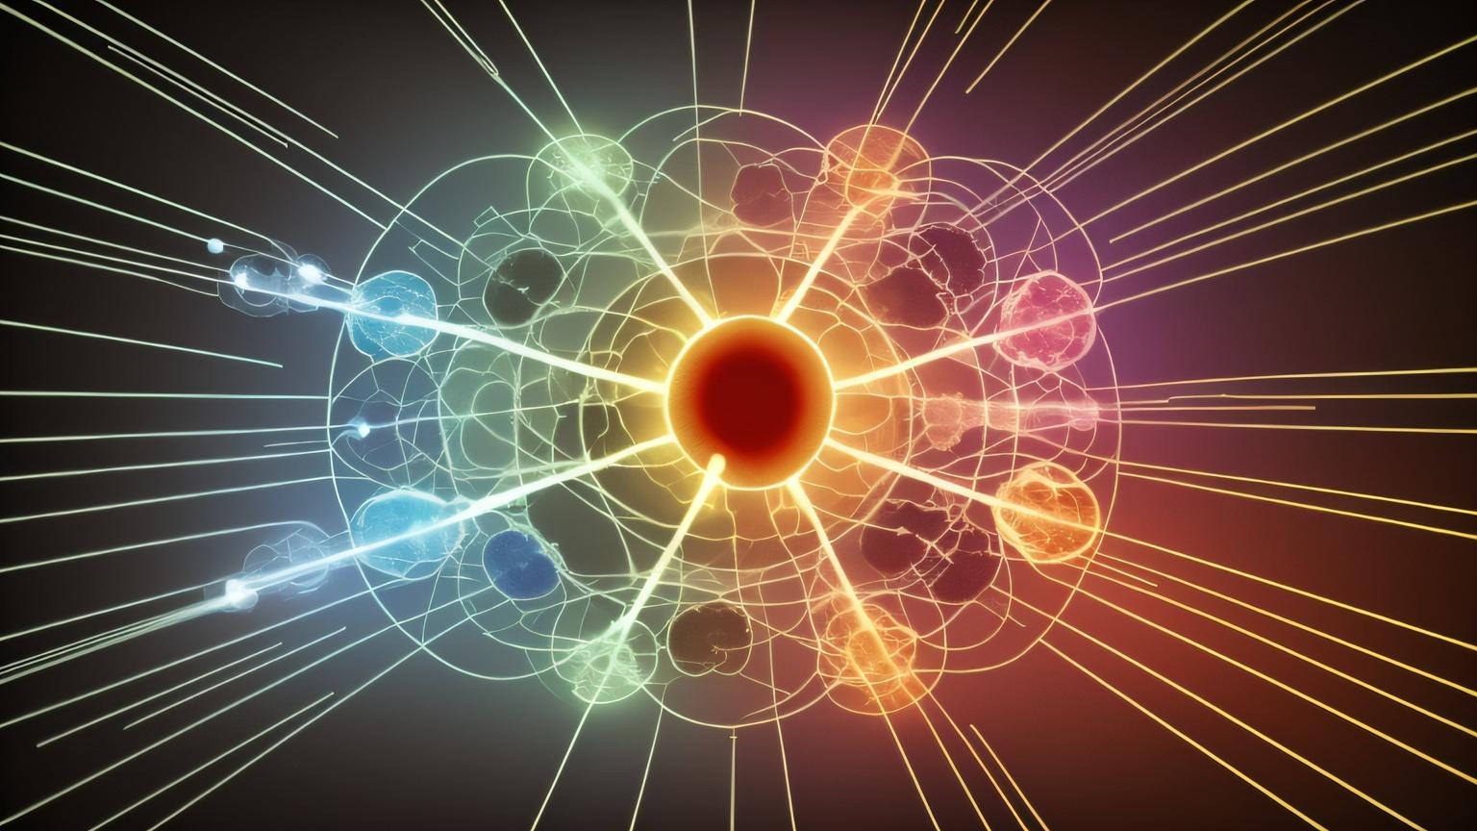
Why Investigate LENR/LANR/LCF/ENC...etc.
Propulsion
Space Exploration
Insights in Physics
Energy Production
Waste Management
Nuclear Medicine
Conscious Energy
Dalle-2 Low energy nuclear reactions on a palladium lattice
made with Autonomous Research Agent (ARA)
Mid-Journey Low Energy Nuclear Reaction
2
Notes:
Energy Production
Waste Management
Nuclear Medicine
Propulsion
Space Exploration
and can help us to get a better understanding of Physics

Slide 5
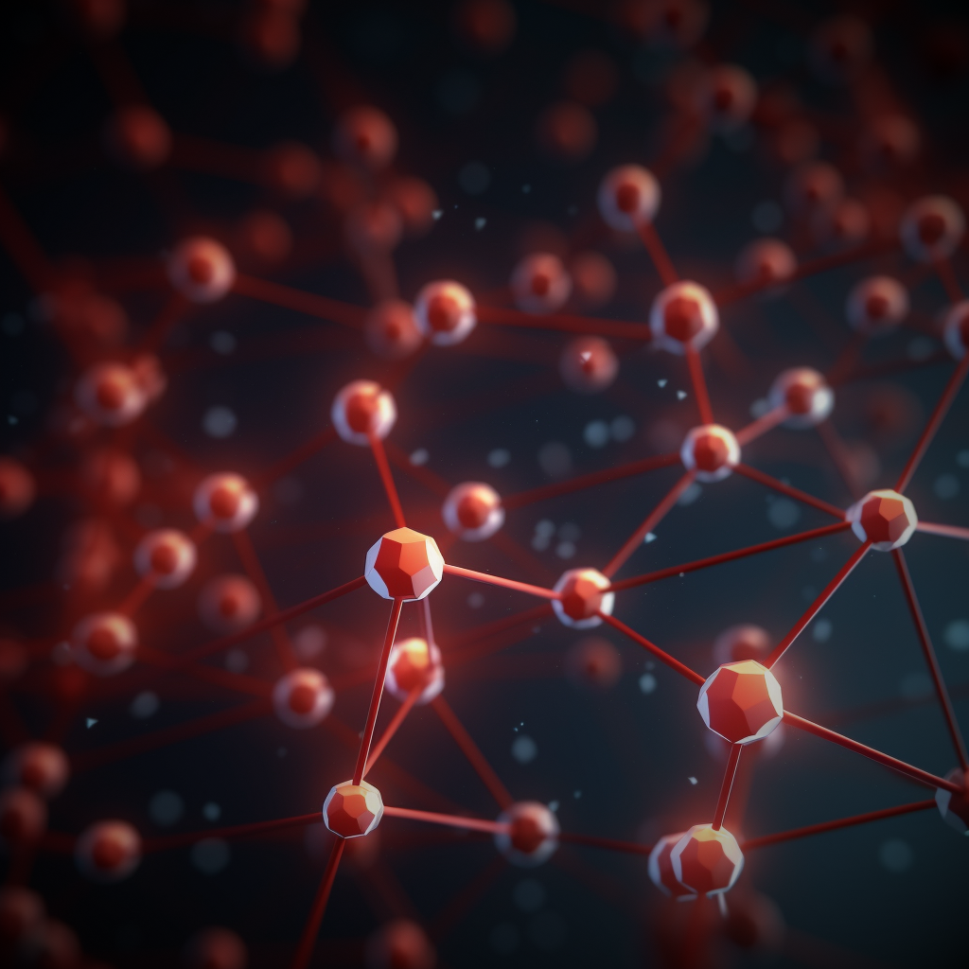
Challenges in Investigating LENR/LANR
Lack of Theoretical Agreement
Prediction and Control
Experiment Design
Replication Challenges
Precision Required
Conscious Energy
3
Notes:
LENR/LANR has many complex challenges.
Lack of Theoretical Agreement
Prediction and Control
Experiment Design
Replication Challenges
Precision Measurement Requirements

Slide 6
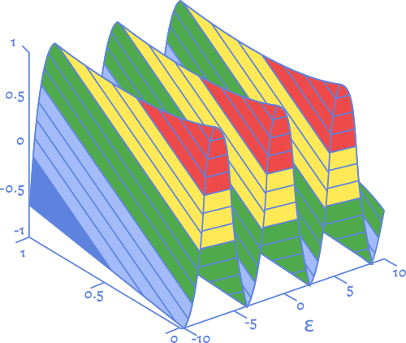

How Machine Learning can help solve these challenges?
Conscious Energy
Model Development
Optimization of Experimental Design
Enhancing Replicability
Data Analysis and Interpretation
Real-time Monitoring and Control
Collaborative Research
Automating Tedious Processes
Enhancing Interpretability
4
Notes:
Model Development: ML can help in developing predictive models that may not fit neatly into existing theoretical frameworks. By analyzing large datasets from experiments, ML can identify patterns and relationships that might be missed by traditional methods.
Optimization of Experimental Design: ML algorithms can be used to optimize experimental conditions, selecting the best parameters to achieve desired results. This can help in controlling the reactions and designing more reliable experiments.
Enhancing Replicability: By using ML to analyze the subtle variations in experimental conditions, researchers can better understand the factors that influence the outcomes.
Data Analysis and Interpretation: ML can handle vast amounts of data, providing insights into complex phenomena.
Real-time Monitoring and Control: ML models can be used for real-time monitoring of experiments, providing immediate feedback and allowing for dynamic adjustments to conditions.
Collaborative Research: ML can facilitate collaboration by enabling the sharing of data and models among researchers. This can foster a more cohesive approach to understanding and controlling these complex reactions.
Automating Tedious Processes: Many experimental processes can be automated using ML, reducing human error and freeing up researchers to focus on more complex tasks.
Enhancing Interpretability: Advanced ML techniques like explainable AI can provide insights into why a particular model is making certain predictions.
In summary, ML offers a multifaceted approach to tackling the complex challenges associated with LENR and LANR, from enhancing theoretical understanding to improving experimental design and replicability.

Slide 7
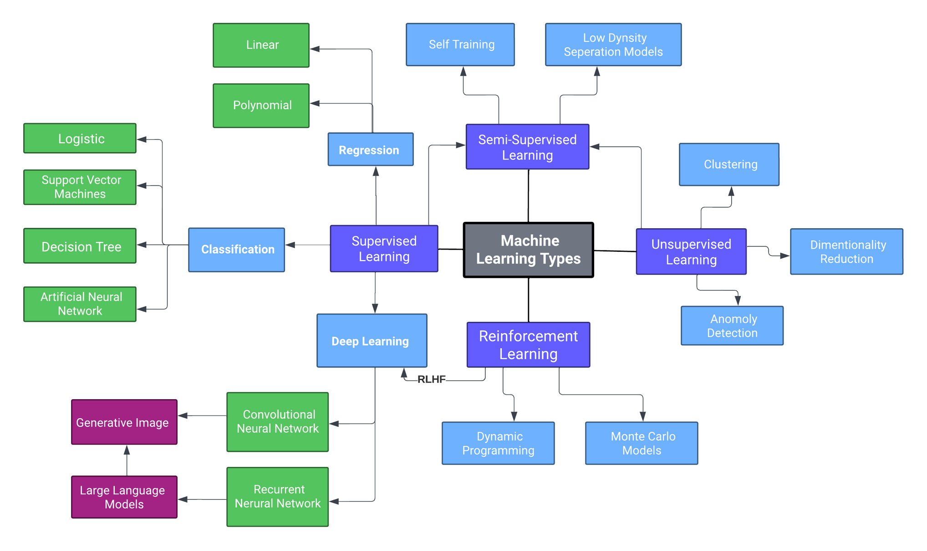
Machine Learning Techniques
Conscious Energy
5
Notes:
Machine learning is a powerful tool for analyzing and interpreting information. It can look at large amounts of data to find patterns, helping researchers to understand how these reactions work.
There are 3 general types of Machine Learning techniques.
Supervised Learning,
Unsupervised Learning,
Reinforcement Learning ,and
Hybridization of these 3 techniques also exist in the form of semi-supervised and Reinforcement Learning with Human Feedback (RLHF).
The popular LLMs like Open AI’s CHatGPT, Google’s Bard, Meta’s Llama2, and Anthropics Claude2 are part of a deep learning neural network family which are built on a Transformer architecture, GPT models use an "attention mechanism" to focus on different parts of the text, replacing older architectures like RNNs and CNNs. To put it simply, Imagine your brain is like a big puzzle-solving machine that helps you talk, think, and understand stuff. GPT models are like a mini-version of that machine but inside a computer. They're really good at helping people chat, answer questions, and write stories. Ofcourse just like people, sometimes they can get a little confused and go insane.

Slide 8
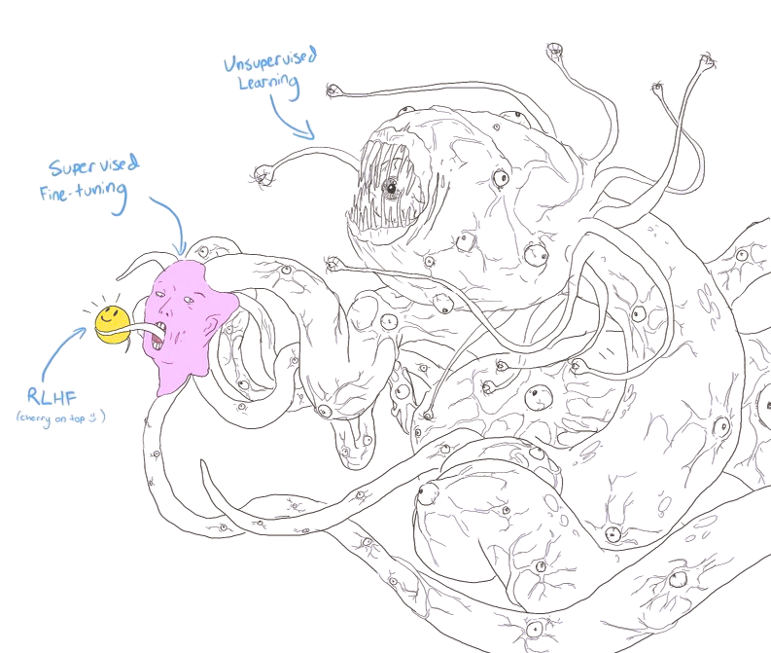
Examples of Machine Learning Techniques
Unsupervised Learning
Learning Type
Description
General Example
Example in LENR
Supervised Learning (Fine-Tuning)
Supervised Learning
Trains on labeled data to make predictions or classifications.
Email spam filtering using labeled spam and non-spam emails.
Predicting nuclear reactions using support vector machines.
Finds patterns without labeled examples, uncovering hidden structures.
Customer segmentation in marketing based on purchasing behavior.
Clustering similar experimental datasets to discover unknown phenomena and recognizable patterns.
Unsupervised Learning
RLHF
Combines labeled and unlabeled data to improve learning efficiency.
Language translation models trained on a mix of labeled translations and large amounts of unlabeled text.
Multi-Model models that translate nanoscale topologies into mathematical language and visa-versa.
Semi-Supervised
Learning
Utilizes artificial neural networks to analyze complex data.
Self-driving cars using deep learning to process visual input and make driving decisions.
Deep Learning
Analyzing gamma ray spectra using convolutional neural networks (CNNs).
Image Source: github.com/Hannibal046/Awesome-LLM
Conscious Energy
6
Notes:
Machine learning techniques offer a wide range of applications in various fields.
Some examples we explored include..
Supervised Learning: Trains on labeled data to make predictions or classifications.
Linear Regression: Used for predicting continuous values, such as forecasting energy consumption.
Support Vector Machines: Applied for classification tasks, like identifying phases of matter.
Neural Networks: Employed in complex pattern recognition, like many body interactions.
Unsupervised Learning: Finds patterns without labeled examples, uncovering hidden structures.
Principal Component Analysis (PCA): Utilized for dimensionality reduction, often in large datasets like material sciences.
Clustering Algorithms (e.g., K-means): Used to group data into clusters without prior labeling, such as grouping similar energy consumption patterns.
Semi-Supervised or Reinforcement Learning: Finds patterns without labeled examples, uncovering hidden structures.
Q-Learning: Implemented in controlling systems, like optimizing parameters in nuclear fusion reactors.
Deep Learning: Utilizes artificial neural networks to analyze complex data.
Convolutional Neural Networks (CNNs): Applied in image analysis, like detecting defects in manufacturing processes or “big brother” tracking us with facial recognition.
Recurrent Neural Networks (RNNs): Used in sequential data processing, such as predicting time-series data in energy consumption.
and ofcourse the now infamous Generative Pre-trained Transformer Models or GPTs, which most people are familiar with in text based generation.
These techniques, with proper tuning and implementation, can solve complex problems in various domains, from energy analysis to nuclear fusion technology.

Slide 9

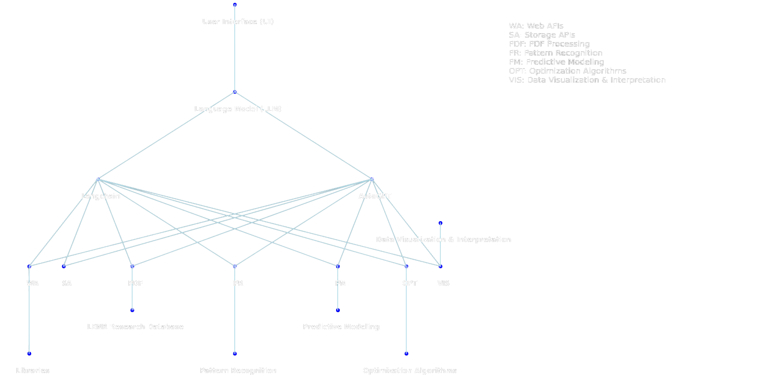




















Autonomous Research Agent (ARA) with LLMs (Large Language Models)
User Interface (UI)
Large
Language Model (LLM)
Legend
WA: Web APIs
SA: Storage APIs
PDF/CSV: PDF & CSV Processing
PR: Pattern Recognition
PM: Predictive Modeling
OPT: Optimization Algorithms
VIS: Data Visualization and Interpretation
Langchain
AutoGPT
Data Visualization & Interpretation
WA
SA
PDF/CSV
PR
PM
OPT
VIS
LENR Research Databases
Predictive Modeling
Conscious Energy
Libraries
Pattern Recognition
Optimization Algorithms
7
Notes:
Recursive self improving Autonomous Agents with the use of LLM's is a powerful tool that can be used with information retrieval to avoid relying on internal LLM knowledge. This can keep the GPT factually accurate. The use of application protocol interfaces (APIs) also allow Autonomous agents to interface with databases, search indexes, code execution, and other tools.
Deploying one or more recursive self improving agents can help with specific tasks that are too complex for a single LLM alone.

Slide 10

Data Sets for Machine Learning
Data Input
Data Sources:
66
Conscious Energy
Data Content:
33
Challenges in Collection:
16.5
Data Preparation
33
Potential
66
Data Output
Generated by Midjourny
8
Notes:
Collecting data sets for machine learning investigations into low energy nuclear reactions can be a challenging task, as the phenomena are often rare and difficult to reproduce. In addition, the data must be carefully curated and preprocessed to ensure that it is suitable for use with machine learning algorithms. This may involve filtering out noise, normalizing the data, or selecting relevant features. Despite these challenges, the use of machine learning techniques has shown promise in uncovering new insights into low energy nuclear reactions.
Data Sources: Experimental observations, simulations, theoretical models.
Data Content: Information on particles, energies, trajectories, reaction conditions, materials, environmental factors.
Challenges in Data
Collection: Phenomena are rare, hard to reproduce, and can be wrapped in IP (intellectual property).
Data Preparation: Careful curation, preprocessing (e.g., noise filtering, normalization, feature selection).
Potential: Machine learning offers promising insights into low energy nuclear reactions.

Slide 11



Data Preprocessing
Conscious Energy
1. Data Collection:
Step 1
4. Data Transformation:
Gather raw data from various sources of focus.
Scale or normalize data, encode categories.
Step 2
Step 3
5. Data Reduction:
2. Data Cleaning:
Reduce complexity without losing essential information.
Remove noise and handle missing values for accuracy.
Step 4
Step 5
3. Data Integration:
Step 6
6. Data Splitting:
Combine different sources into one coherent dataset.
Divide into training, validation, and testing sets for model evaluation.
9
Notes:
Data preprocessing is a crucial step in utilizing machine learning techniques for investigating low energy nuclear reactions.
1. Data Collection: Gather raw data from various sources of focus.
2. Data Cleaning: Remove noise and handle missing values for accuracy.
3. Data Integration: Combine different sources into one coherent dataset.
4. Data Transformation: Scale or normalize data, encode categories.
5. Data Reduction: Reduce complexity without losing essential information.
6. Data Splitting:
Divide into training, validation, and testing sets for model evaluation.
Goal: Create a manageable dataset that retains essential qualities, reducing computational costs, and enhancing model performance.

Slide 12
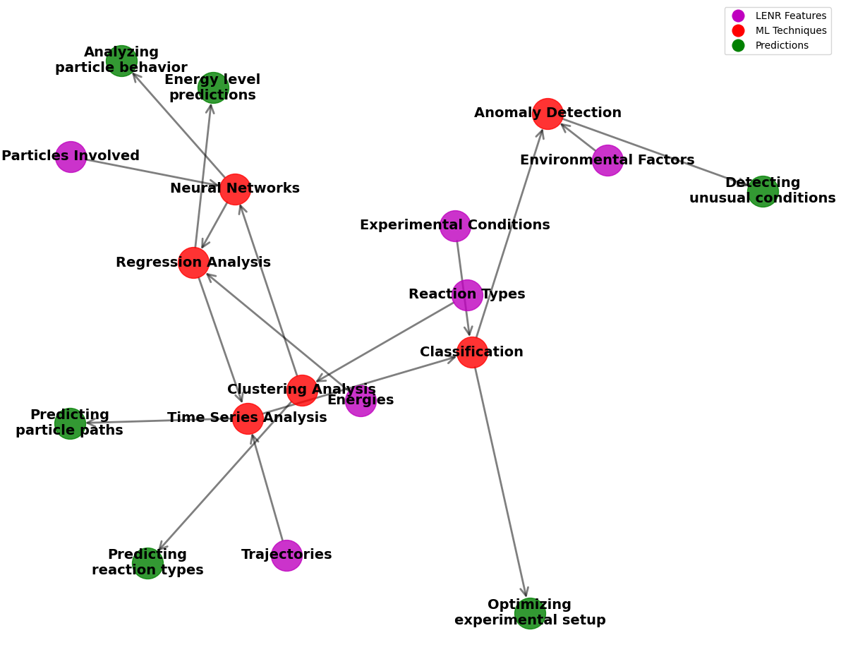
Feature Selection
Think of it this way:
- We have lots of information (features) about these reactions.
- Some of this information is really helpful, while some might not be.
- Feature selection helps us choose the best information to make our predictions more accurate and is an input to the neural network.
Conscious Energy
Data Visualization generated by GPT4 and Code Interpreter
10
Notes:
Feature selection is the process of picking the most important clues to understand a subject matter or function, for example low energy nuclear reactions, in machine learning. It's about finding the key details that really matter for predicting how these reactions will work according to nature.
We can use different methods to pick these key details, like checking how closely they're connected to what we are attempting to predict, how well they separate different types of reactions, and how consistent they are in various experiments.

Slide 13

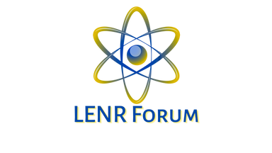
Methodology of Machine Learning in LENR/LANR and Preliminary Results
Historical Analysis
Statistical Analysis
Theoretical Analysis
Experimental Commonalities
Predictive Models and Simulations
Conscious Energy
11
Notes:
We used applied machine learning techniques to various aspects of low energy nuclear reactions (LENR) and lattice-assisted nuclear reactions (LANR). One important application is predicting reaction outcomes.
By analyzing data from previous experiments, machine learning algorithms can identify patterns and make predictions about the likelihood of certain reactions occurring under complex conditions. This information can help researchers optimize experimental conditions and improve the efficiency of their R & D.
Another application of machine learning in LENR and LANR is optimizing experimental conditions. Machine learning algorithms can analyze large amounts of data from multiple sources, including sensor readings and experimental results, to identify the optimal conditions for a given reaction. This can save researchers time and resources by reducing the number of experiments needed to achieve desired results.

Slide 14
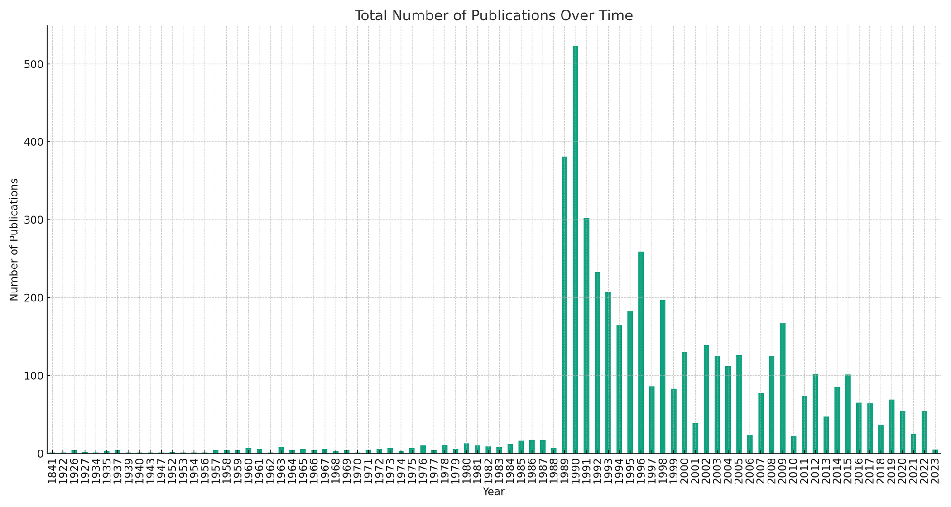
Historical Statistical Analysis of LENR using Machine Learning
[Publications over time from www.lenr-canr.org and www.arxiv datasets with ChatGPT-4 embeddings.]
Conscious Energy
12
Notes:
Using generative pre-trained transformer models like LLMs with quality datasets and python libraries can be a novel statistical analysis tool. Here we used our ARA to compile Publications over time and create a visual representation for the data.
It looks like something interesting happened in 1989? ;)

Slide 15
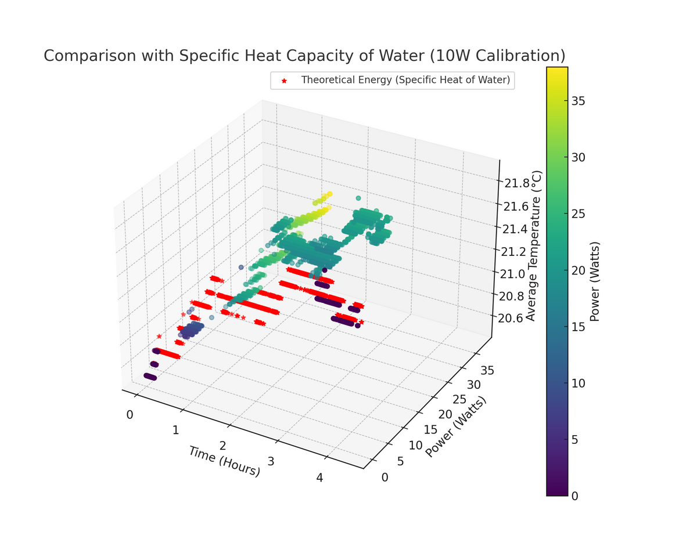
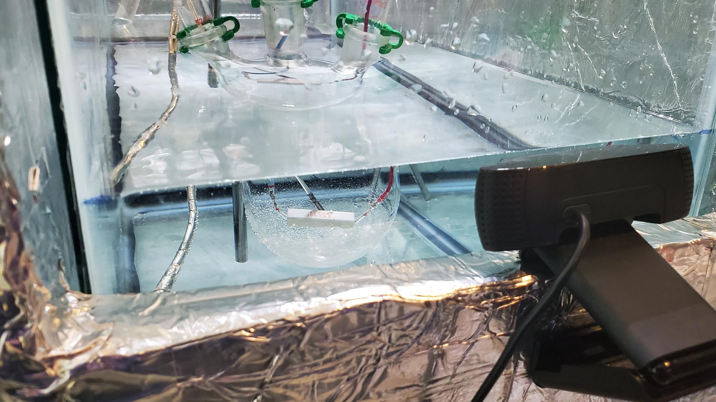
Statistical Analysis Experiments
Conscious Energy
Statistical Analysis using ChatGPT4 and Code Interpreter of Project Proteus 10watt calibration
13
Notes:
This is a 3D Plot visual analysis for the specific heat capacity of 600ml of water for calorimetry.
The later plasma electrolysis experiments failed however due to strong EMI.

Slide 16
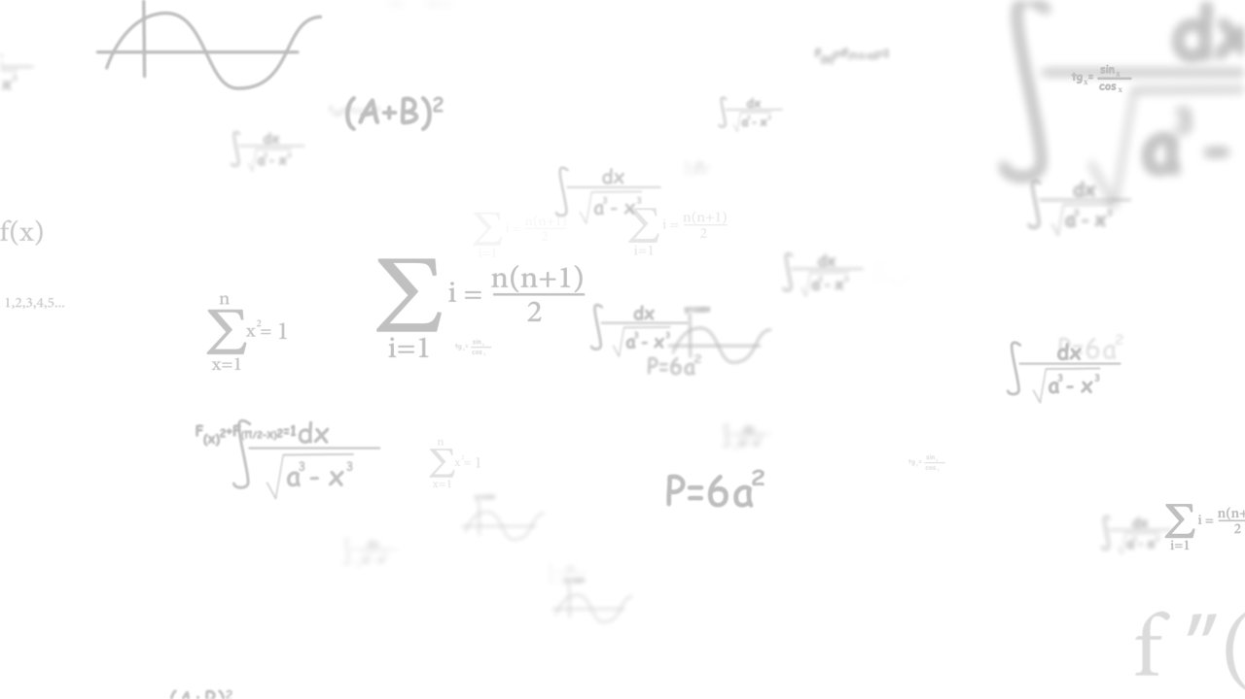
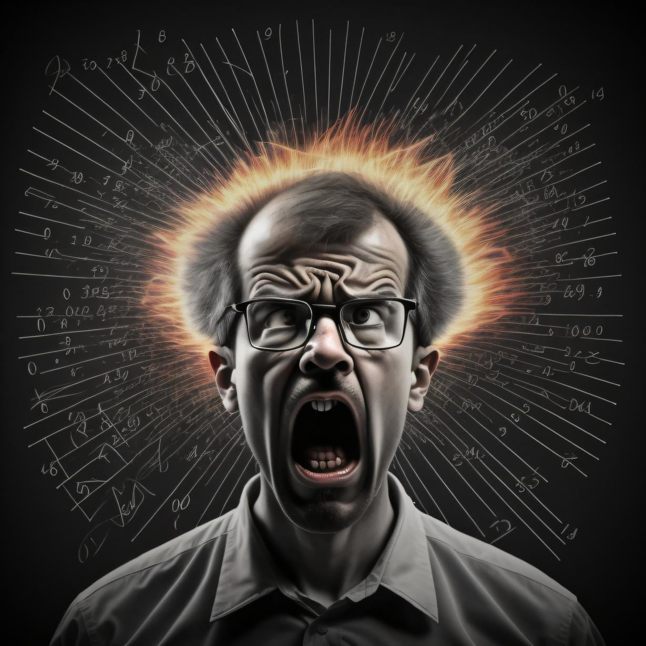
Quantum Electrodynamics Theory
Quantum Fusion Hypothesis
Hydrino Theory
Resonant Nuclear Reaction Theory
Coherent Quantum Fluctuations Theory
Neutron Transfer Reaction Theory
Bose-Einstein Condensate Theory
Plasma Oscillation Theory
Quantum Mechanical Tunneling Theory
Nuclear Catalysis Theory
Electroweak Theory
Collective Effects Theory
Nuclear Excitation by Electron Capture Theory
Nuclear Excitation by Electron Transition Theory
Quantum Field Theory
Nuclear Isomer Theory
Nuclear Lattice Energy Theory
Nuclear Magnetic Resonance Theory
Nuclear Reaction Theory
Nuclear Resonance Theory
Nuclear Spin Theory
Nuclear Structure Theory
Nuclear Theory
Nuclear Transfer Reaction Theory
Nuclear Transmutation Theory
Nuclear Vibrational Energy Theory
Nuclear Transmutation Theory
Nuclear Vibrational Energy Theory
Theoretical Model Data Collection
Nuclear Wave Function Theory
Nuclear Weak Interaction Theory
Nucleon Cluster Model Theory
Nucleon Pairing Theory
Nucleon Transfer Reaction Theory
Nucleon Transmutation Theory
Nucleon Vibrational Energy Theory
Nucleon Wave Function Theory
Nucleon Weak Interaction Theory
Nucleus Cluster Model Theory
Nucleus Pairing Theory
Nucleus Transfer Reaction Theory
Nucleus Transmutation Theory
Nucleus Vibrational Energy Theory
Nucleus Wave Function Theory
Nucleus Weak Interaction Theory
Particle Cluster Model Theory
Particle Pairing Theory
Particle Transfer Reaction Theory
Particle Transmutation Theory
Particle Vibrational Energy Theory
Particle Wave Function Theory
Particle Weak Interaction Theory
Storm's Theory
Takahashi's TSC Theory
Hagelstein's Theory
Widom-Larsen Theory
Holmlid's Theory
etc.....
Image generated by Midjourney
Conscious Energy
14
Notes:
We collected 60+ theories on mathematical models for Nuclear Fusion. That’s enough to make any researchers head explode!

Slide 17
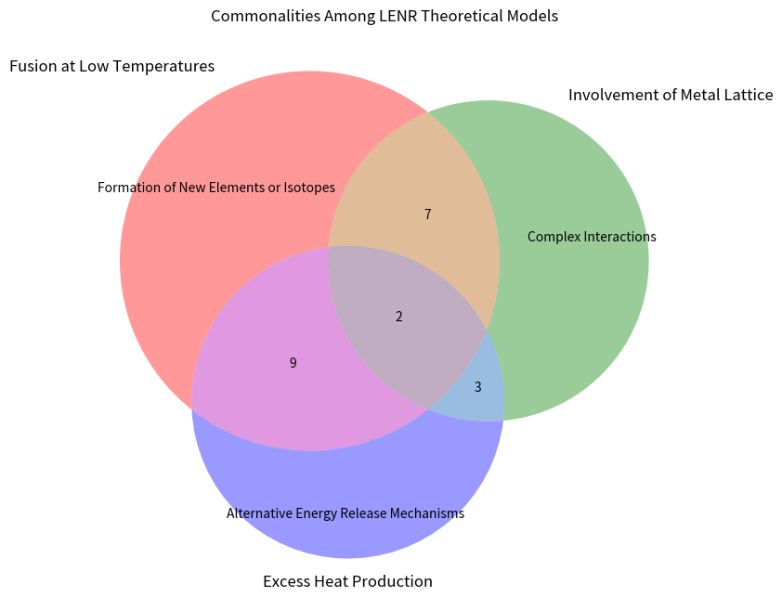
Theoretical Model Analysis
Fusion at Low Temperatures
Involvement of Metal Lattice
Formation of New Elements or Isotopes
Complex Interactions
Alternative Energy Release Mechanisms
Excess Heat Production
Excess Heat Production
Conscious Energy
15
Notes:
Here is a visualization using a Venn diagram created by our ARA which shows the similarities of the 10 popular models.
1. Classic D-D Fusion Models
2. Screening Potential Model
3. Hydrided Metal Lattice Model
4. Plasma Oscillation Model
5. Non-nuclear Models
6. Widom-Larsen Theory
7. Holmlid Theory
8. Hagelstein Theory
9. Storms Theory
10. Takahashi's Tetrahedral Symmetric Condensate (TSC) Theory

Slide 18
Conscious Energy
Predictive Model Simulations
Basic LENR-ARA (Autonomous Research Assistant) Simulation Using Python
16
Notes:
This is a simplified preliminary predictive model simulation generated with the help of ARA. (Automated Research Agent)

Slide 19

Limitations of Machine Learning in LENR and LANR
Conscious Energy
17
Notes:
While machine learning offers insights into low energy nuclear reactions (LENR), limitations exist. The lack of model interpretability and dependence on quality data can hinder understanding. In LENR, limited data may affect model accuracy.
Additionally, intellectual property restrictions can further impede LENR development. Combining machine learning with theoretical modeling or experimental investigations may provide a more comprehensive understanding, overcoming these challenges with collaboration across multiple disciplines in an open source environment.

Slide 20
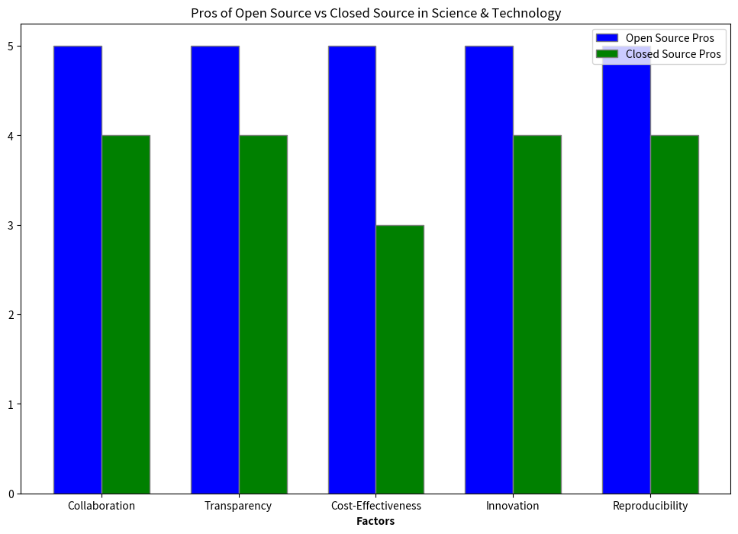
Collaboration with Open Science and Technology
Conscious Energy
ChatGPT4 Model analysis of Open vs Closed Source
18
Notes:
Collaboration and open science are crucial components in advancing research on low energy nuclear reactions. Due to the complexity of this field, researchers from different disciplines must work together to share data and knowledge. Collaboration can lead to new insights and breakthroughs that would not have been possible otherwise. Additionally, open science practices such as sharing data and results openly can help to increase transparency and reproducibility in research.
Open Source
Pros:
1. Collaboration: Enables researchers and developers to collaborate across disciplines and countries.
2. Transparency: Code and methods are publicly available, making it easier to identify errors or biases.
3. Cost-Effective: Generally free to use, allowing for greater accessibility, especially for smaller labs or startups.
4. Accelerated Innovation**: Anyone can contribute, leading to faster development and the incorporation of the best ideas.
5. Reproducibility: Easier for other scientists to reproduce experiments and verify results.
Cons:
1. Quality Variability: Open-source projects may lack the polish or support of commercial software.
2. Security Risks: Open nature may expose vulnerabilities, although these often get quickly patched.
3. Initial Complexity: May have a steeper learning curve due to lack of dedicated customer support.
4. Funding: Sustaining large open-source projects can be financially challenging without a consistent funding model.
5. Fragmentation: Multiple versions or forks can create confusion and dilute community focus.
Closed Source
Pros:
1. Quality Assurance: Often backed by companies offering support and consistent updates.
2. User-Friendly: Generally easier to use, with better documentation and user interfaces.
3. Security: Source code is not exposed, providing some level of inherent security.
4. Funding: Commercial model ensures a stream of funding for ongoing development.
5. Standardization: Proprietary software often sets industry standards due to widespread adoption.
Cons:
1. High Cost: Licensing fees can be prohibitive for smaller organizations or individual researchers.
2. Limited Customization: Users can't modify the software to fit their specific needs.
3. Vendor Lock-in: Users are dependent on a single vendor for updates and support.
4. Transparency: Lack of transparency can hinder scientific verification and peer review.
5. Collaboration: Proprietary nature can limit collaborative efforts and the sharing of knowledge.

Slide 21
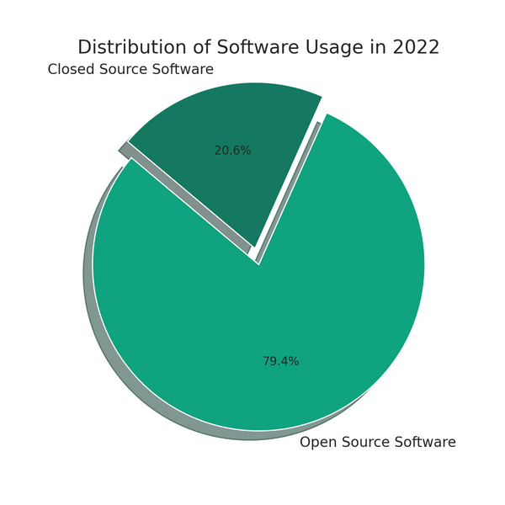
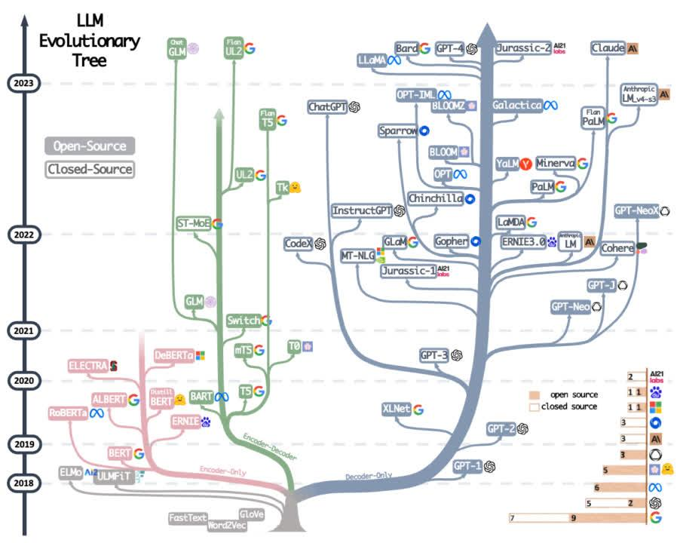
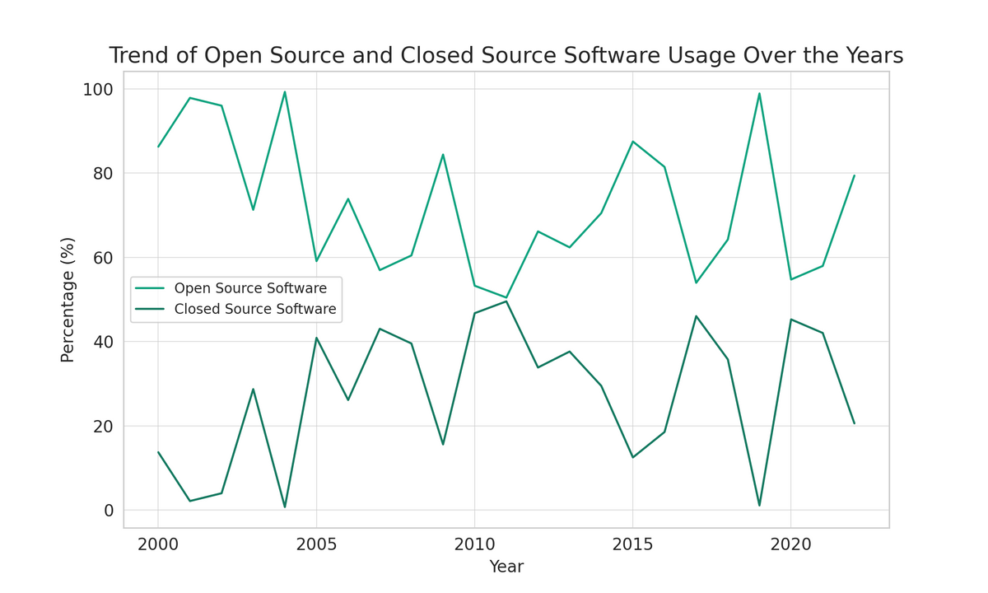
Open Source vs Closed Source for Technological Adoption Rates
LLM evolutionary tree is open source code reliant
Trend of Open and Closed Source Software use since 2000
Image Source: github.com/Hannibal046/Awesome-LLM
Data gathered by autonomous search of Wikipedia, Serper, and Arxiv using ARA and ChatGPT-3.5-Turbo
19
Notes:
A fantastic example of the power of Open source science and technology is in the recent innovations of LLM’s. Due to there generally open-source nature, they are a wonderful representation of rapid adoption, an increase in technological innovation, and transparency to easily replicate existing applications. I wonder if this type of open source economic model would be advantageous for the LENR field?

Slide 22

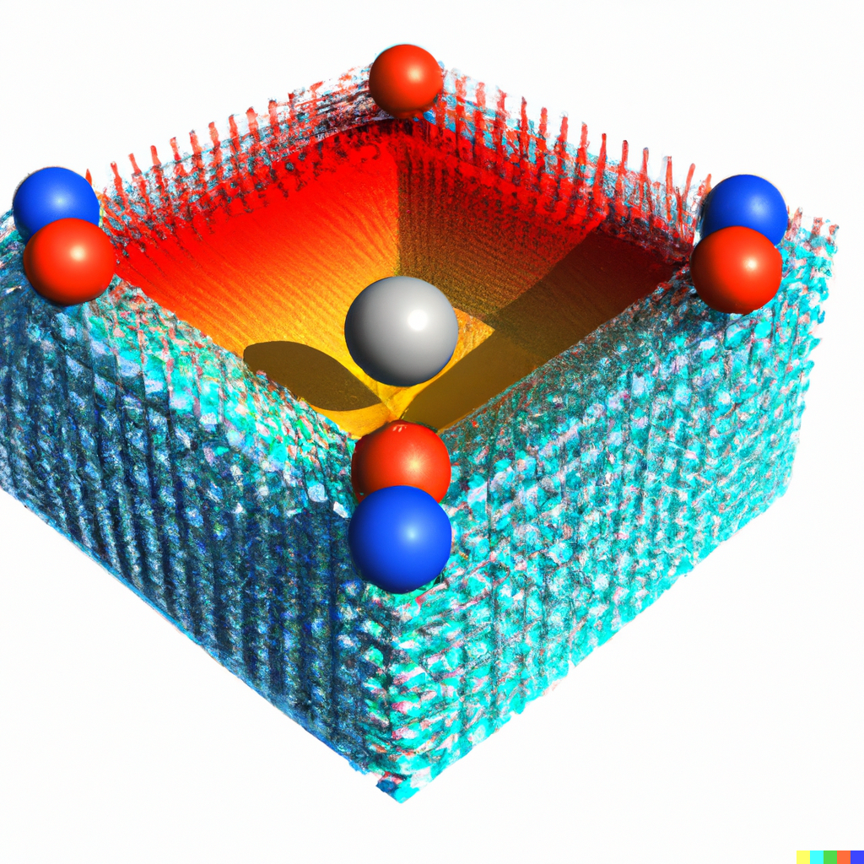
Future Directions for Research
One machine learning task that requires further investigation is the underlying mechanism behind LENR. Future research should focus on developing better models that explain the observed phenomena.
Another area needing attention is the reproducibility of
experiments. Difficulties in replication leads to skepticism about the results. New techniques for controlling experimental conditions and reducing sources of error will help to address this issue.
Dalle2 Palladium Lattice Heavy Electron Trap (NAE)
Conscious Energy
20
Notes:
One machine learning task that requires further investigation in which most researchers agree on is the underlying mechanism behind LENR. Future research should focus on developing better models that explain the observed phenomena.
Another area needing attention is the reproducibility of
experiments. Difficulties in replication leads to skepticism about the results. New techniques for controlling experimental conditions and reducing sources of error will help to address this issue.

Slide 23
Conclusion
Utilizing machine learning techniques for investigating low energy nuclear reactions holds great promise for advancing our understanding of this complex phenomenon. By analyzing large and complex data sets, machine learning can reveal patterns and relationships that would be difficult or impossible to detect through traditional methods. Through supervised, unsupervised, and deep learning techniques, researchers have already made significant progress in identifying key features and predicting reaction outcomes.
However, it is important to recognize the limitations of machine learning and the need for collaboration with other fields of study. While machine learning can provide valuable insights, it cannot replace the need for theoretical understanding and experimental validation from observations.
Moving forward, it will be essential for researchers to work together and share knowledge in an open and collaborative manner to advance the field of low energy nuclear reactions to help create prosperity and abundant energy for all of humanity.
Conscious Energy
21
Notes:
Utilizing machine learning techniques for investigating low energy nuclear reactions holds great promise for advancing our understanding of this complex phenomenon. By analyzing large and complex data sets, machine learning can reveal patterns and relationships that would be difficult or impossible to detect through traditional methods. Through supervised, unsupervised, and deep learning techniques, researchers have already made significant progress in identifying key features and predicting reaction outcomes.
However, it is important to recognize the limitations of machine learning and the need for collaboration with other fields of study. While machine learning can provide valuable insights, it cannot replace the need for theoretical understanding and experimental validation from observations.
Moving forward, it will be essential for researchers to work together and share knowledge in an open and collaborative manner to advance the field of low energy nuclear reactions to help create prosperity and abundant energy for all of humanity.

Slide 24
Acknowledgments
The research presented in this presentation has been made possible through the contributions of many individuals and organizations. We would like to extend our gratitude to the researchers who have dedicated their time and expertise to investigating low energy nuclear reactions and developing machine learning techniques for this purpose.
I would also like to acknowledge the support of all the people who donated to my GoFundMe campaign to be able to come to ICCF25.
I also would like to extend a special thanks to Jed Rothwell for providing an open library for LENR/LANR and all my fellow colleagues at LENR-Forum for encouraging me to come to ICCF25.
Thank you Konrad Czerski and the University of Szczecin for hosting.
Bin Juine Huang
Adrienne Freese
Alaina Worden
Paul Richey
David Nygren
Thomas Acs
Robert Christian
Nils Dehne
Alan Smith
Albin Marty
Samuel North
Robin Carter
Suzanne Lamb
David Nagel
Lee and Valerie Richey
Robert Ellefson
Shane Daigle
Peter Darling
Ruth Orellano
Jeff & Erica Long
Scott Harrison
Alan Smith
Tim Woodman
Shane Daigle
and the 10 Anonymous Donations
Conscious Energy
23
Notes:
The research presented in this presentation has been made possible through the contributions of many individuals and organizations. We would like to extend our gratitude to the researchers who have dedicated their time and expertise to investigating low energy nuclear reactions and developing machine learning techniques for this purpose.
I would also like to acknowledge the support of all the people who donated to my GoFundMe campaign to be able to come to ICCF25.
I also would like to extend a special thanks to Jed Rothwell for providing an open library for LENR/LANR and all my fellow colleagues at LENR-Forum for encouraging me to come to ICCF25.
Thank you Konrad Czerski and the University of Szczecin for hosting.

Slide 25
Contact Information
For more information about our research on utilizing machine learning techniques for investigating low energy nuclear reactions, please visit our website at www.conscious.energy and www.lenr-forum.com
If you have any questions or comments, please feel free to contact us at diadon@conscious.energy
All reference citation can be found at www.conscious.energy/UMLENR for the links to the technical paper, datasets, and python code.
We welcome collaboration and are always interested in discussing potential partnerships.
Conscious Energy
22

